Slide 1
STEM Perceptions: Student & Parent Study Parents and Students Weigh in on How to Inspire the Next Generation of Doctors, Scientists, Software Developers and Engineers
Commissioned by Microsoft Corp.

Slide 2
Introduction
As part of its broader efforts to help improve STEM education, Microsoft Corp. commissioned two national surveys with Harris Interactive among college students pursuing science, technology, engineering and math (STEM) degrees, and parents of K–12 students. The goal of the surveys was to gain insight about what can better prepare and inspire students to pursue post-secondary education in STEM subjects. In these surveys, parents and students were asked about their perceptions and attitudes of STEM education in the U.S., shedding light on how to inspire more young people to become doctors, scientists and engineers.
For more information on Microsoft’s STEM commitments, please read our press release.
Note: Survey research methodology is detailed in the appendix of this report.

Slide 3
Executive Summary: Parent Perceptions
Parents were asked about their perception of STEM education in K–12, and the survey found broad agreement that there is room for improvement.
While most parents of K–12 students (93%) believe that STEM education should be a priority in the U.S., only half (49%) agree that it actually is a top priority for this country.
Parents who feel that STEM should be a priority feel this way because they want to ensure the U.S. remains competitive in the global marketplace (53%) and to produce the next generation of innovators (51%); fewer say it’s to enable students to have well-paying (36%) or fulfilling careers (30%).
Even though many parents (50%) would like to see their children pursue a STEM career, only 24% are extremely willing to spend extra money helping their children be successful in their math and science classes.

Slide 4
Executive Summary: Student Perceptions
College students pursuing a STEM degree were asked to rate how well their K–12 education prepared them for their college courses in STEM, and why they chose to pursue a STEM academic path.
Importance of K–12 Education:
For many, the decision to study STEM starts before college.
Nearly 4 in 5 STEM college students (78%) say that they decided to study STEM in high school or earlier. One in five (21%) decide in middle school or earlier.
More than half (57%) of STEM college students say that, before going to college, a teacher or class got them interested in STEM.
This is especially true of female students (68% vs. 51% males), who give “a teacher or class” as the top factor that sparked their interest.
Preparedness:
Only 1 in 5 STEM college students feel that their K–12 education prepared them extremely well for their college courses in STEM.
Students who felt less prepared for STEM college courses said that offering more STEM courses and having better/more challenging courses would have helped to better prepare them — and for students who felt extremely/very well-prepared, it was the challenging, college-prep courses that helped to prepare them.
Females in STEM are more likely than males to say they were extremely/very well-prepared (64% vs. 49%) by their K–12 education, and they are slightly more likely than their male counterparts to say that preparing students for STEM should be a top priority in K–12 schools (92% vs. 84%).

Slide 5
Executive Summary: Student Perceptions
Motivation:
Based on the college student survey findings, the motivation to pursue STEM studies did not originate from their parents telling them to select that subject area or even because they know the U.S. is in need of STEM graduates.
Rather, students indicate they are selecting a STEM path to secure their own futures.
68% say they want a good salary.
66% say it’s the job potential.
68% say they find their degree program subject intellectually stimulating and challenging.
Gender Differences:
The inspiration for choosing STEM varied quite a bit between males and females.
Male students are more likely to pursue STEM because they have always enjoyed games/toys, reading books, and/or participating in clubs that are focused on their chosen subject area (51% vs. 35% females).
Female students are more likely to say that they chose STEM to make a difference (49% vs. 34% males).

Slide 6
SURVEY FINDINGS

Slide 7
Among careers tested, the two careers parents most want their child to pursue are scientist and engineer; overall, half of parents say they would like their child to pursue a STEM career. On the other hand, parents think their kids are more interested in becoming performers or artists.
Parents who give their child’s school an “A” on its ability to prepare students for careers in STEM are more likely to say their child wants to pursue a STEM career (52% vs. 38% give school a “B” or lower).
Parent and Child Career Hopes
Reported by parents; top responses shown
Dads are more likely to want their child to pursue a STEM career (57% vs. 44% moms).
Teacher
Entrepreneur
Business
Executive
Lawyer
Artist or Designer
Financial
Professional
Actor/Musician/Performer
Military
Personnel
Professional Athlete
No Preferences /Don’t Know
Base: All Parents of Child in Grades K–12 (n=854)
Q1020: Which of the following careers, if any, would you like your child to pursue? Which of the following, if any, do you think your child will want to pursue?

Slide 8
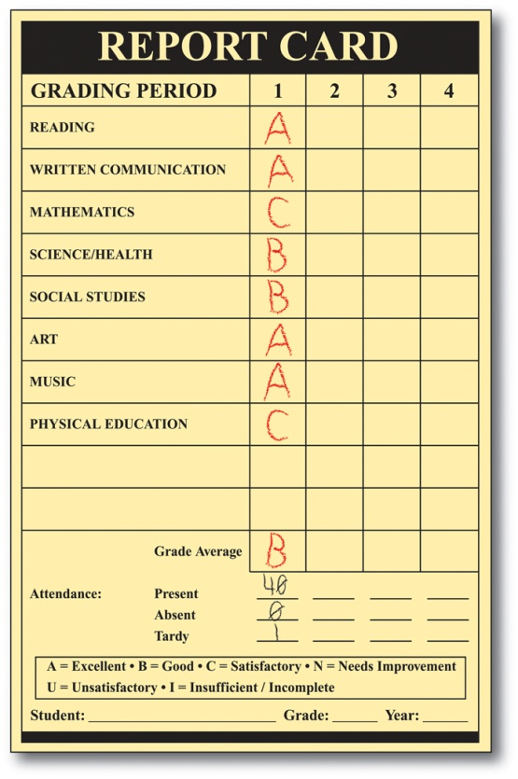
Parents and STEM students agree that there is room for improvement in K–12 STEM education — only 1 in 5 STEM students feel they were extremely well-prepared for their college STEM courses.
STEM College Students: How Well Did Your K–12 Education Prepare You for College?
What did your school do to help prepare you?
Parent Rating of K–12 STEM Prep
“AP courses were offered at my high school so I was able to gain a good foundation in Calculus and Physics.”
Grade | Total Parents
A | 28%
B | 41%
C | 22%
D | 7%
F | 3%
Average Grade: B
“My schools prepared me for college workloads by sometimes giving college entry level work. Also quite often we would be given opportunities to take a college course or something of that sort.”
Females in STEM are more likely than males to say they were extremely/well- prepared
(64% vs. 49%)
What could your school have done to better prepare you?
“More in-depth curriculum.”
“Offer more AP courses and also more opportunities for hands-on experience and programs with each field.”
“More application, less theory.”
Base: All Qualified Respondents (College Students: n=500, Parents of Child in Grades K–12: n=854)
Q910: How well did your K–12 education (elementary through high school) prepare you for your college courses in science, technology, engineering and/or math?
Q915: What could your school have done to better prepare you/What did your school do that helped prepare you for your college courses in STEM? (OPEN END)
Q1055: What grade would you give your child’s school on its ability to prepare students for careers in science, technology, engineering and/or mathematics?

Slide 9
The majority of college students and parents believe that preparing students for careers in STEM should be a priority for K–12 schools in the U.S.; however, only half believe it actually is a top priority in schools.
The State of STEM Education in the U.S.
% agree among students and parents
Female students are more likely than their male counterparts to say that preparing students for STEM should be a top priority in K–12 schools (92% vs. 84%) — another indication of how important K–12 education is for girls.
STEM College Students
Parents of K–12 Students
While parents may feel that K–12 schools are not meeting expectations when it comes to STEM, many are not extremely willing to spend their own money helping their children be successful in their math and science classes (24% extremely willing vs. 37% very willing, 34% somewhat willing, and 5% not at all willing).
________
____
__
76% of parents feel that the U.S. is doing a poor job of teaching STEM compared to other countries.
Base: All Qualified Respondents (College Students: n=500, Parents of Child in Grades K-12: n=854)
Q940/Q1060: How strongly do you agree or disagree with each of the following statements?
Q1050: How willing would you be to spend extra money to help your child(ren) be successful in their math and science classes?

Slide 10
So why do parents feel that STEM education should be a priority? About half say it’s to ensure that the U.S. remains competitive in the global marketplace and also to produce the next generation of innovators. Preparing students to have well-paying and fulfilling careers are less important.
Parents: Why Should Preparing Students for STEM Careers Be a Top Priority for Schools in the U.S.?
Up to 3 responses selected
Dads are more likely than moms to list this is a reason (62% vs. 47% moms).
Parents in high-income households are least likely to give enabling students to have well-paying careers as a reason (29% in $75K+ households vs. 37% in <$35K, 42% $35–49.9K, 46% in $50–74.9K).
Moms are more likely than dads to list this as a reason (36% vs. 22% dads).
Base: Parents who agree that STEM preparation should be a top priority for schools (n=774)
Q1065: Why do you think preparing students for careers in STEM should be a top priority for schools in the United States. Please select up to three responses.

Slide 11
Students are choosing to pursue a STEM degree, not because someone encouraged or told them to or even because the U.S. is in need, but to secure their own futures and because they find it intellectually stimulating/challenging.
Reasons College Students Choose STEM Degrees
#1 reason for males and
pre-med students
#1 reason for females and
engineering & science students
#1 reason for technology students (Note: Does not make top 3 list for any other major)
Male students are more likely to pursue STEM because they have always enjoyed games/toys, etc. (51% vs. 35% females).
Female students are more likely than male students to say that they chose STEM to make a difference (49% vs. 34% males).
Of all STEM students, pre-med are most likely to give this is a reason (67% vs. 50% in science, 35% in engineering and 12% in technology).
Black and Hispanic students are less likely than white and Asian students to say they chose STEM because they were encouraged by a teacher or guidance counselor.
Base: All College Students (n=500)
Q810: Why did you choose to pursue this type of education?

Slide 12
Nearly 4 in 5 STEM college students say that they decided to study STEM in high school or earlier, and parents say STEM interest begins at an early age.
Parents: What Is Your Child’s Favorite Subject in School?
STEM Students: When Did You DECIDE You Wanted to Study STEM?
Average Age INTEREST Began
 | 8.2
 | 7.2
 | 7.5
 | *
 | *
 | *
 | *
 | *
 | 6.3
 | 4.9
 | 5.5
 | 9.4
 | 5.2
 | N/A
Students that felt they were only somewhat or not at all prepared in K–12 for STEM courses are more likely to have decided to pursue a STEM degree in college (26% vs. 16% students who were extremely/very well-prepared).
*Base is too small to report. Note: other subjects tested include Social Studies, English, Foreign Language and Geography. All had 5% or less as favorite subject.
Base: All Parents of Child in K–12 (n=854) Q1035: What is your child’s favorite subject in school?
Base: Child has a favorite subject listed (variable base by subject) Q1040: At what age did your child become interested in [FAVORITE SUBJECT]?
Base: All College Students(n=500) Q830: When did you decide that you wanted to be pre-med/to study your area or major in school?

Slide 13
About a third of college students say that no one had the most influence on their decision to pursue STEM — the same is true of parents who are in STEM fields today. However, over half of students say that a teacher or class got them interested in STEM. Half also said that media, games and toys played a role.
WHO Had the MOST Influence on Your Decision to Pursue STEM?
Reported by students and parents in STEM careers
STEM Students: Before College,
WHAT Got You Interested in STEM?
#1 for females
#1 for males
37% of STEM college students have a parent in STEM.
“I took 2 classes in high school where the teachers were really good at making it interesting and I realized how much I like this.”
– Math Student
“Video games got me into this area.”
– Tech Student
Base: Parents in STEM Careers (n=132) Q1005: When you were a child, who was the most influential person
in your life in helping you decide what career to pursue?
Base: All College Students (n=500) Q820: Who had the most influence on your decision to study in this area?; Q840: Before going to college, which of the following got you interested in science, technology, engineering and/or mathematics?; Q845: Please tell us specifically what got you interested in science, technology, engineering and/or mathematics.
= significant difference between males and females.

Slide 14
Although a good K–12 education is necessary for building a foundation and interest in STEM, students say that having a passion for STEM and studying hard are the two most important factors to their success. External factors, such as K–12 education, mentors and role models, are less important.
Female students are more likely to cite “studying hard” as an important success factor (81% vs. 60% males).
STEM Students: How Important Is Each Factor to Your Success?
% Absolutely Essential/Extremely Important
Female students are more likely than males to say “supportive parents” is an important success factor (50% vs. 37% males).
Base: All College Students (n=500)
Q920: How important are each of the following to your success as a student studying in your area or major?

Slide 15
Nearly three-quarters of STEM students report that their parents had at least some influence on their decision to study STEM; many parents want their child to pursue a STEM career and almost none discourage it.
Students: Parent Influence and Encouragement
Parents: How influential do you think you will be on your child’s future career path?
How influential were your parents on your decision to study STEM?
Percentage that said “At least somewhat influential”: 73%
Females more likely than males to say their mother was extremely influential and encouraged a lot.
Percentage that said “At least somewhat influential”: 72%
Percentage that said
“At least somewhat influential”: 97%
While few parents have discouraged STEM careers, students who have parents in STEM careers are more likely to say their parent influenced and encouraged them.
Growing up, to what extent did your parents encourage or discourage you from pursuing a career in STEM?
Percentage that said “Encouraged”: 67%
Percentage that said “Encouraged”: 66%
Base: College Students with mother/father in life (variable base) Q880: How influential were your mother and father on your decision to be pre-med/to study in your area or major?
Q890: When you were growing up, to what extent did you mother and father encourage or discourage you from pursuing a career in science, technology, engineering or mathematics?
Base: All Parents of Child in Grades K–12 (n=854) Q1015: How influential do you think you will be on your child(ren)’s future, specifically the career path they may decide to pursue?

Slide 16
Parents have high, unmet expectations for schools when it comes to STEM education, but are they willing to help make up the difference themselves?
Parents: How Willing Would You Be to Spend Money to Help Your Child Be Successful in Math and Science?
Parents: How Confident Are You Helping Your Child With Their Math and Science Homework?
61%
Extremely/very willing
Dads (58% vs. 42% moms) and parents in STEM careers (68% vs. 43% non-STEM careers) are more confident in their abilities to help.
Parents: If You Had an Extra $100 to Spend Each Month on Your Child, How Would You Be Most Likely to Spend It?
Music, art, or dance lessons
Enrichment program in math or science
Sports team expenses
Clothing
Entertain-
ment
Enrichment program in reading or LA
A cell phone
Some other way
Base: All Parents of Child in Grades K–12 (n=854)
Q1045: How confident are you that you have the skills to help your child with their math and science homework if they asked for your assistance?
Q1050: How willing would you be to spend money to help your child(ren) be successful in their math and science classes?
Q1030: Assuming all of your child’s basic needs are met, if you had an extra $100 to spend each month on your child, in which of the following ways would you be most likely to spend that money?

Slide 17
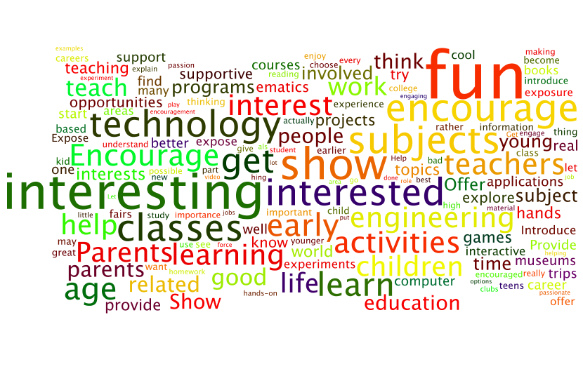
STEM Students: What Can Parents and Schools Do to Help Kids and Teens Become Interested in STEM?
“Fun games — see how science, technology, engineering, and mathematics are actually applicable to real life.”
—Engineering Student
“Expose them at an early age, show them it is fun and interesting.”
—Biomedical Sciences Student
“Parents can be more hands on and supportive in teaching their children outside of school to help reinforce what is learned in school. Schools should also have a lot more hands on and visual learning rather than always reading from the textbook. For example, instead of reading about photosynthesis take the students outside and show them photosynthesis.” —Pre-Med Student
Base: All College Students (n=500)
Q950: What can parents and schools do to help kids and teens become interested in science, technology, engineering and mathematics?
The word cloud illustrates keywords used by students to indicate how parents and schools can make STEM more interesting for kids. Larger words represent higher frequencies while smaller words represent lower frequencies.

Slide 18
APPENDIX

Slide 19
Research Methodology
Two surveys were conducted online within the United States by Harris Interactive on behalf of Waggener Edstrom Worldwide/Microsoft:
The parent survey was conducted from May 4–11, 2011, among 1,074 parents of children ages 17 or younger using the Harris Interactive ParentQuery omnibus. Total sample responding to Waggener Edstrom Worldwide/Microsoft questions includes 854 respondents. Those answering these questions were parents of K–12 students. Data were weighted to be representative of U.S. adults with 0–17-year-olds in the household.
The student survey was conducted from May 9–12, 2011 among 500 U.S. undergraduate college students, ages 18–24, who are currently pursuing a STEM degree. Data were weighted to be representative of U.S. undergraduate college students between the ages of 18–24.
All sample surveys and polls, whether or not they use probability sampling, are subject to multiple sources of error, which are most often not possible to quantify or estimate, including sampling error, coverage error, error associated with nonresponse, error associated with question wording and response options, and post-survey weighting and adjustments. Therefore, Harris Interactive avoids the words “margin of error” as they are misleading. All that can be calculated are different possible sampling errors with different probabilities for pure, unweighted, random samples with 100% response rates. These are only theoretical because no published polls come close to this ideal.

Slide 20
About Harris Interactive
Harris Interactive is one of the world’s leading custom market research firms, leveraging research, technology and business acumen to transform relevant insight into actionable foresight. Known widely for the Harris Poll and for pioneering innovative research methodologies, Harris offers expertise in a wide range of industries including healthcare, technology, public affairs, energy, telecommunications, financial services, insurance, media, retail, restaurant, and consumer package goods. Serving clients in over 215 countries and territories through our North American, European, and Asian offices and a network of independent research firms, Harris specializes in delivering research solutions that help us — and our clients — stay ahead of what’s next. For more information, visit http://www.harrisinteractive.com.

